Slide 1
Year 6 SATs
Information for parents and carers 2025

Slide 2
What are SATs?
SATs are tests taken by children at the end of Year 6. The test papers are set by the DfE and they are not marked by school.
There are tests in Reading, Grammar, Punctuation and Spelling (GPaS) and Maths.
The tests are done over 4 days in May.
Monday 12 to Thursday 15 May

Slide 3
When are the SATs?
Children will sit the following SATs papers:
Monday 12 May
Grammar, Punctuation and Spelling (Paper 1)
Grammar, Punctuation and Spelling (Paper 2)
Tuesday 13 May
Reading
Wednesday 14 May
Maths Paper 1 (Arithmetic)
Maths Paper 2 (Reasoning)
Thursday 15 May
Maths Paper 3 (Reasoning)

Slide 4
What happens if my child is poorly and can’t attend school on the day of a test?
The tests have to be taken on the set days. This is when all Y6 children in England take the same test.
If your child is poorly, we ask DfE if they can sit the test when they are well enough.
It is important to make sure your child is at school for the tests as it is not as nice for your child to do the test by themselves when they return.

Slide 5
How we help pupils
Adjusted curriculum for 8 days (potential)
Adjusted test arrangements for some pupils
Masterclass
Quality first teaching for all pupils

Slide 6
What pupils said last year about the way we prepare the pupils for the tests
88% of pupils felt the change of timetable in the lead up to the tests helped them.
90% of the pupils felt well prepared for the maths test
89% of the pupils felt well prepared for the English tests
94% of pupils felt the school gave them the right amount of support.
96% of the pupils thought the well being lesson each day before the tests was really helpful.

Slide 7
Rewards!
Wellbeing and motivation
Increased amount of PE lessons in the lead up
Free Swim Vouchers
Ice cream van on the Friday of test week.
Social activities afternoon

Slide 8
How long are the tests? What happens?
The standard timings of tests are shown but some children are entitled to extra time for specific reasons set by DfE:
Grammar, Punctuation and Spelling (Paper 1) – 45 minutes;
Grammar, Punctuation and Spelling (Paper 2) – 15 minutes;
Reading – 60 minutes;
Maths Paper 1 (Arithmetic) – 30 minutes;
Maths Paper 2 (Reasoning) – 40 minutes;
Maths Paper 3 (Reasoning) – 40 minutes
The tests will take place during normal school hours, under exam conditions.
Children are not allowed to talk to each other from the moment the test papers are handed out until they are collected.
Afterwards, the completed papers are sent away to be marked externally.
The children’s results are sent back to school at some point in July.

Slide 9
Specific arrangements for SATs
Children with additional needs (who have similar support as part of day-to-day learning in school) may be allotted specific arrangements, including:
Additional (extra) time;
Tests being opened early to be modified;
An adult to scribe (write) for them;
Using word processors independently;
An adult to read for them (including a translator);
The use of prompts or rest breaks;
Arrangements for children who are ill or injured at the time of the tests.
Pupils with an EHCP are automatically allowed up to 25% additional time (except for the spelling paper, which is not strictly timed). Pupils who use the modified large print or braille versions of the tests are automatically allowed up to 100% additional time.
Notes:
The DfE Key Stage 2 access arrangements guidance (https://assets.publishing.service.gov.uk/government/uploads/system/uploads/attachment_data/file/1109963/2023_key_stage_2_access_arrangements_guidance.pdf) gives more details on this, including which arrangements need prior permission.
It should be noted that there are cases when pupils can have access to multiple arrangements (e.g. addition time and a scribe). These are detailed in the above document.
Also note, any pupil can ask for a question to be read to them, though not explained to them. In mathematics, words and numbers may be read but mathematical symbols cannot be read.

Slide 10
What do the tests look like?
GPaS Paper 1: the questions can be based on any grammar content taught during KS1 and KS2
This covers: all aspects of punctuation, word classes and sentence construction, verb tenses, vocabulary and Standard English.

Slide 11
GPaS paper 2 Spelling
Consists of 20 spellings based on the Y5 and 6 spelling patterns: e.g. homophones and other words that are often confused, suffixes, prefixes etc
See p140 of planner for Y5 & 6 spellings

Slide 12
Reading
The text can be poetry, fiction, non-fiction but also include posters, diagrams, graphs/ tables etc

Slide 13
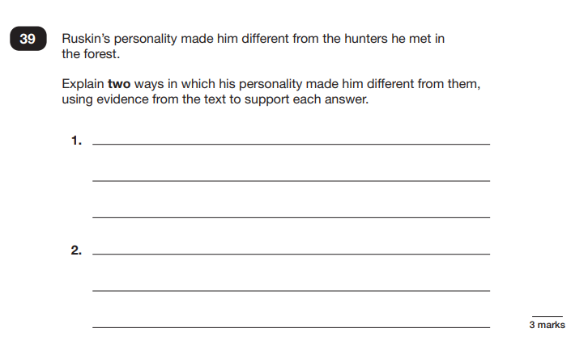
Reading

Slide 14
How is my child’s writing assessed?
There is no writing test.
Writing is assessed using evidence collected throughout Year 6. Your child’s writing in English lessons is used to see if they have met the specific criteria in the:
Writing Teacher Assessment Frameworks designed by DfE. (TAFs).
E.g. use the range of punctuation taught at key stage 2 mostly correctly
• maintain legibility in joined handwriting when writing at speed.
To make sure each school makes accurate decisions, the DfE ask Local Authorities to check teacher assessment judgements and the evidence used to make them. A sample of schools are moderated each year.

Slide 15
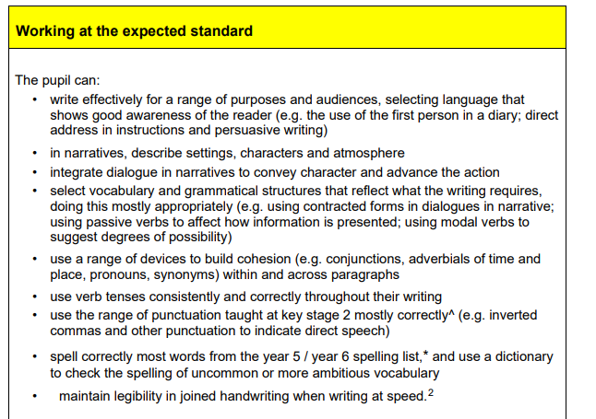
How is my child’s writing assessed?

Slide 16
Maths tests
Wednesday 14 May- 2 on one day
Maths Paper 1 (Arithmetic)
Maths Paper 2 (Reasoning)
Thursday 15 May
Maths Paper 3 (Reasoning)
Total marks: 110
Expected standard last year was 54 marks.
Break in between

Slide 17
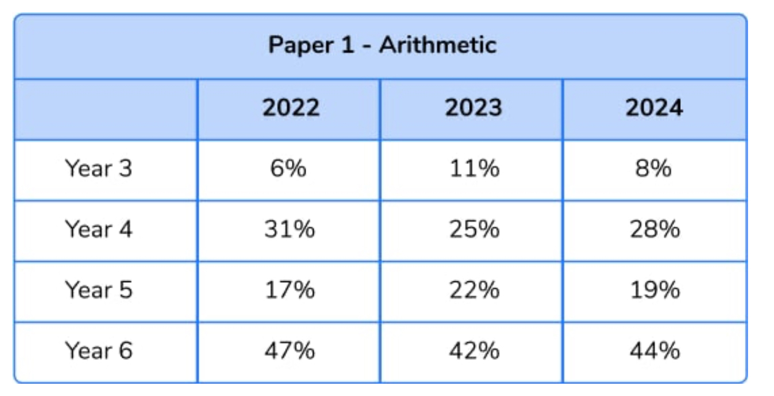
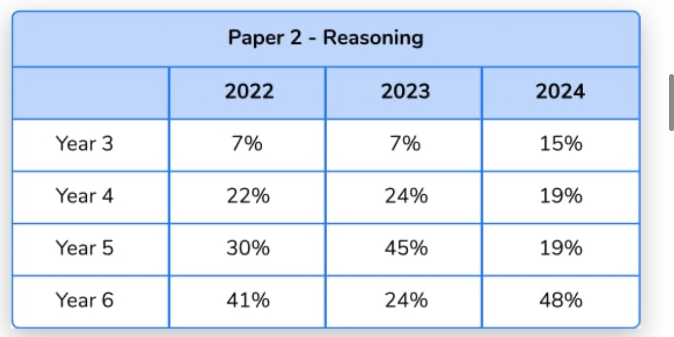
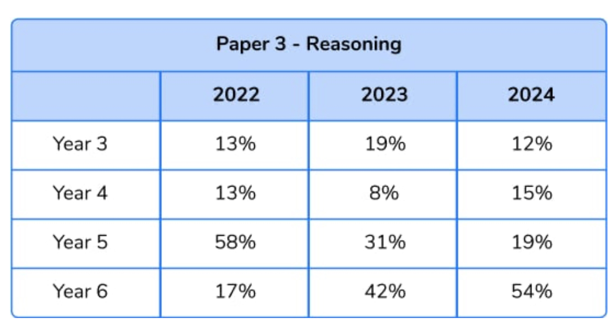
Content for the SAT papers are taken from the Year 3- 6 curriculum

Slide 18
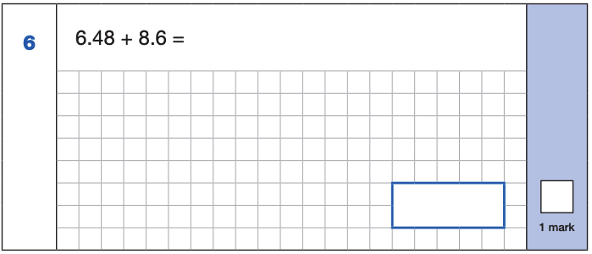
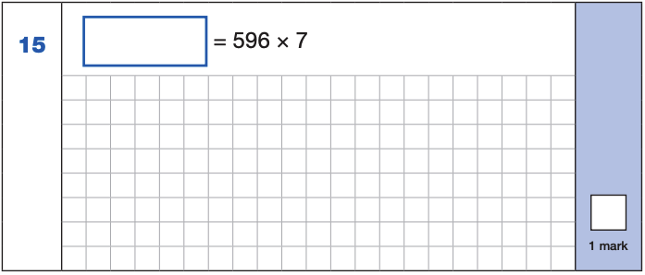
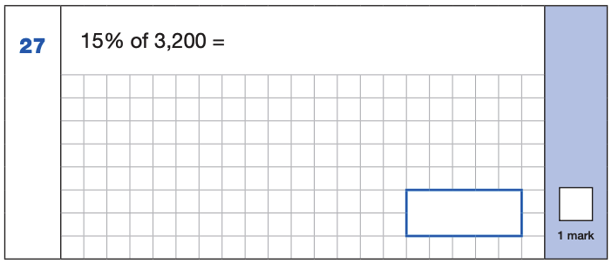
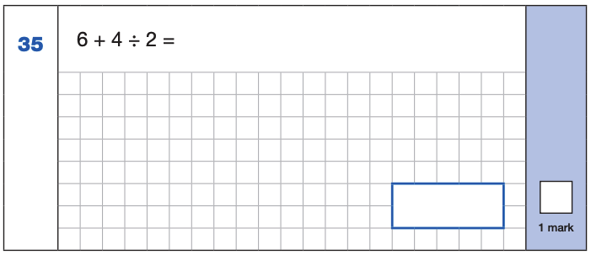
The maths arithmetic paper has a total of 40 marks and lasts for 30 minutes.
The test covers the four operations (addition, subtraction, multiplication, division, including order of operations requiring BIDMAS), percentages of amounts and calculating with decimals and fractions.
ONE MARK
4,172
6.48
+ 8.6 .
15.08
¹
596
x 7
4172
⁶ ⁴
15.08
10% of 3,200 = 320
5% of 3,200 = 160
15% of 3,200 = 480
4 ÷ 2 = 2
6 + 2 = 8
480
8

Slide 19
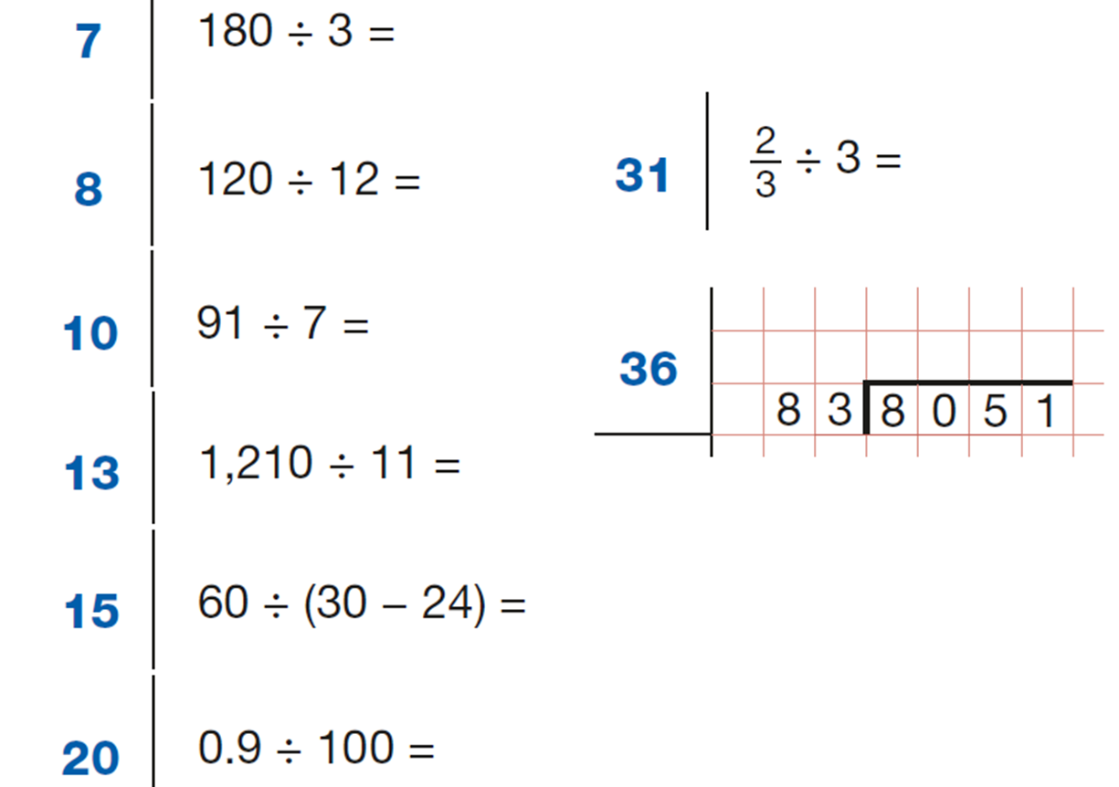
Use of mental strategies
TIMES TABLES

Slide 20
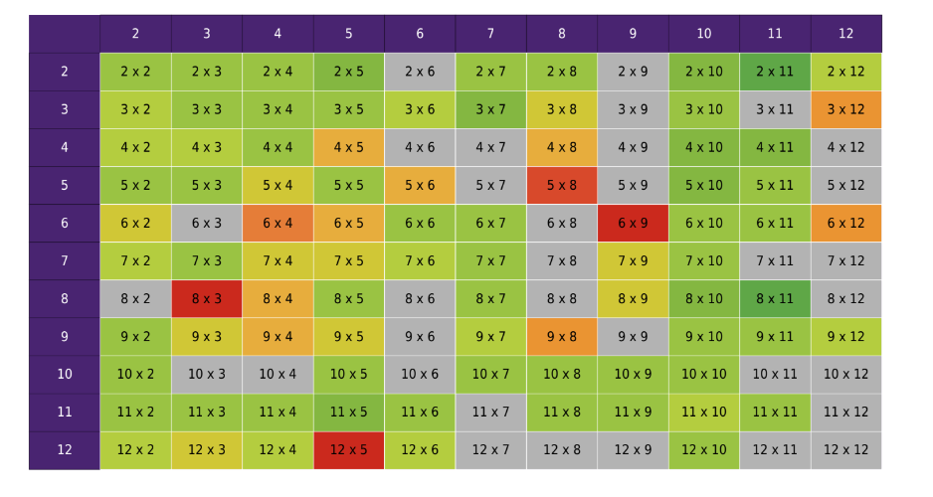
Heatmaps

Slide 21
A sledgehammer to crack a nut
Strategies that are not effective:
9
9
1
0
1
97
0
1
1
16
1 0 0 0
- 7
9 9 3
x 100
- 9
00
7
000
9700
0 8
9700
7 5 6
5
Notes:
It is also important to know when not to use an algorithm, for example in calculating things like:
1002 – 998
101 + 99
100 × 46 or even 50 × 46
300 ÷ 50
… where more flexible mental methods would be more appropriate than a standard algorithm being used as a ‘sledge hammer to crack a nut’.

Slide 22
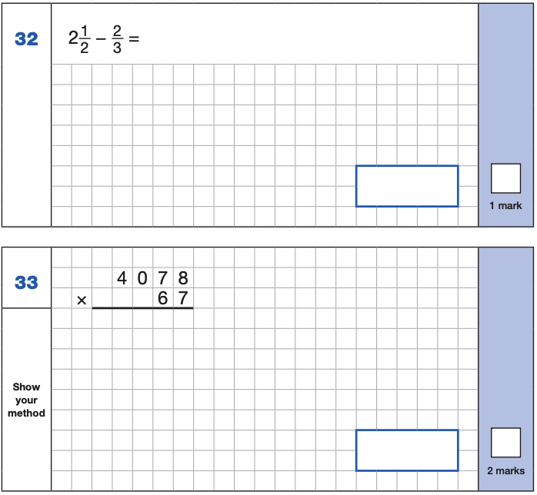
Maths Paper 1 (Arithmetic)
10 3 13
20 6 26
30 9 39
Videos on the website
Notes:
Identify that there are some questions that have 2 marks and some that have 1.

Slide 23
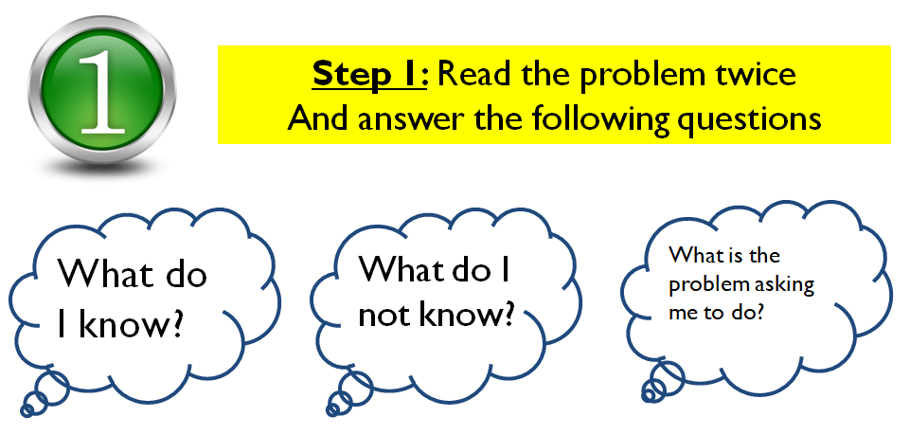
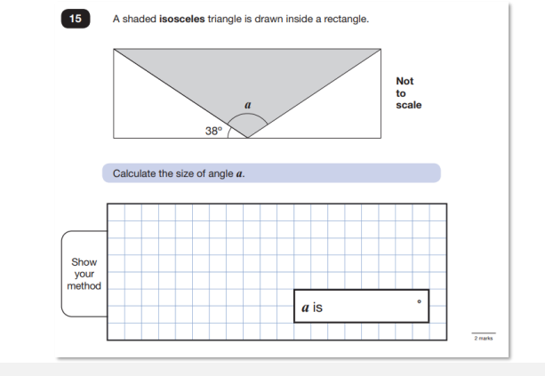
Maths Papers 2 and 3 Reasoning
Questions cover content from Y3- Y6.
40 mins test
Questions range in marks given to each one ( 1- 3)

Slide 24
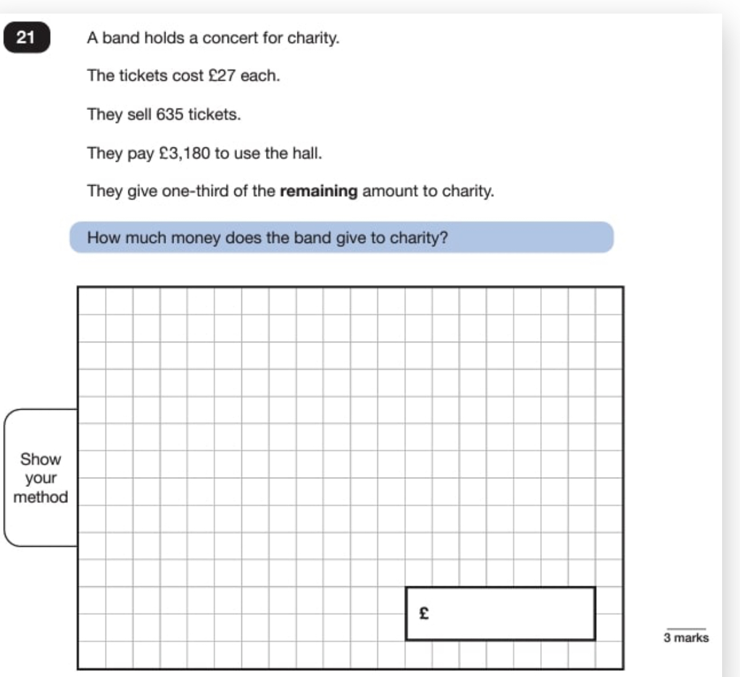
Maths Papers 2 and 3 Reasoning
Questions cover content from Y3- Y6.

Slide 25
MBMS Maths Website
SAT support for parents and pupils
Pupils to know their table facts
Written methods
CGP books
Arithmetic booklets

