Slide 1
Year 6 SATs
Information for parents and carers 2023/24

Slide 2
What are SATs?
SATs are tests taken by children at the end of Year 6. The test papers are set by the DfE and they are not marked by school.
There are tests in Reading, Grammar, Punctuation and Spelling (GPaS) and Maths.
The tests are done over 4 days in May.
Mon 13 to Thur 16 May

Slide 3
When are the SATs?
Children will sit the following SATs papers:
Monday 13 May
Grammar, Punctuation and Spelling (Paper 1)
Grammar, Punctuation and Spelling (Paper 2)
Tuesday 14 May
Reading
Wednesday 15 May
Maths Paper 1 (Arithmetic)
Maths Paper 2 (Reasoning)
Thursday 16 May
Maths Paper 3 (Reasoning)

Slide 4
What happens if my child is poorly and can’t attend school on the day of a test?
The tests have to be taken on the set days. This is when all Y6 children in England take the same test.
If your child is poorly, we ask DfE if they can sit the test when they are well enough.
It is important to make sure your child is at school for the tests as it is not as nice for your child to do the test by themselves when they return.

Slide 5
How we help pupils
Adjusted curriculum for 8 days
Adjusted test arrangements for some pupils
Masterclass
Quality first teaching for all pupils

Slide 6
What pupils said last year about the way we prepare the pupils for the tests
88% of pupils felt the change of timetable in the lead up to the tests helped them.
90% of the pupils felt well prepared for the maths test
89% of the pupils felt well prepared for the English tests
94% of pupils felt the school gave them the right amount of support.
47% of pupils attended a superboost session after school but not all said they were helpful - we have changed this.
96% of the pupils thought the well being lesson each day before the tests was really helpful.

Slide 7
Rewards
PE session every day (8 days before)
Silent disco wellbeing session
Free Swim Vouchers
Ice cream van on the Friday of test week.
Visit to St Mary’s Lighthouse for rock pooling and beach games.

Slide 8
How long are the tests? What happens?
The standard timings of tests are shown but some children are entitled to extra time for specific reasons set by DfE:
Grammar, Punctuation and Spelling (Paper 1) – 45 minutes; Grammar, Punctuation and Spelling (Paper 2) – 15 minutes; Reading – 60 minutes; Maths Paper 1 (Arithmetic) – 30 minutes;
Maths Paper 2 (Reasoning) – 40 minutes;
Maths Paper 3 (Reasoning) – 40 minutes
The tests will take place during normal school hours, under exam conditions.
Children are not allowed to talk to each other from the moment the test papers are handed out until they are collected.
Afterwards, the completed papers are sent away to be marked externally.
The children’s results are sent back to school at some point in July.

Slide 9
Specific arrangements for SATs
Children with additional needs (who have similar support as part of day-to-day learning in school) may be allotted specific arrangements, including:
Additional (extra) time;
Tests being opened early to be modified;
An adult to scribe (write) for them;
Using word processors independently;
An adult to read for them (including a translator);
The use of prompts or rest breaks;
Arrangements for children who are ill or injured at the time of the tests.
Pupils with an EHCP are automatically allowed up to 25% additional time (except for the spelling paper, which is not strictly timed). Pupils who use the modified large print or braille versions of the tests are automatically allowed up to 100% additional time.
Notes:
The DfE Key Stage 2 access arrangements guidance (https://assets.publishing.service.gov.uk/government/uploads/system/uploads/attachment_data/file/1109963/2023_key_stage_2_access_arrangements_guidance.pdf) gives more details on this, including which arrangements need prior permission.
It should be noted that there are cases when pupils can have access to multiple arrangements (e.g. addition time and a scribe). These are detailed in the above document.
Also note, any pupil can ask for a question to be read to them, though not explained to them. In mathematics, words and numbers may be read but mathematical symbols cannot be read.

Slide 10
What do the tests look like?
GPaS Paper 1: the questions can be based on any grammar content taught during KS1 and KS2
This covers: all aspects of punctuation, word classes and sentence construction, verb tenses, vocabulary and Standard English.

Slide 11
GPaS paper 2 Spelling
Consists of 20 spellings based on the Y5 and 6 spelling patterns: e.g. homophones and other words that are often confused, suffixes, prefixes etc
See p140 of planner for Y5 & 6 spellings

Slide 12
Reading
The text can be poetry, fiction, non-fiction but also include posters, diagrams, graphs/ tables etc

Slide 13
How is my child’s writing assessed?
There is no writing test.
Writing is assessed using evidence collected throughout Year 6. Your child’s writing in English lessons is used to see if they have met the specific criteria in the:
Writing Teacher Assessment Frameworks designed by DfE. (TAFs).
E.g. use the range of punctuation taught at key stage 2 mostly correctly
• maintain legibility in joined handwriting when writing at speed.
To make sure each school makes accurate decisions, the DfE ask Local Authorities to check teacher assessment judgements and the evidence used to make them. A sample of schools are moderated each year.

Slide 14
Maths tests
Wednesday 15 May- 2 on one day
Maths Paper 1 (Arithmetic)
Maths Paper 2 (Reasoning)
Thursday 16 May
Maths Paper 3 (Reasoning)
Total marks: 110
Expected standard is usually around 60 marks.

Slide 15
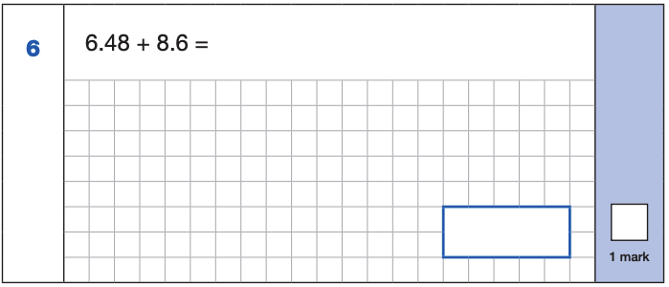
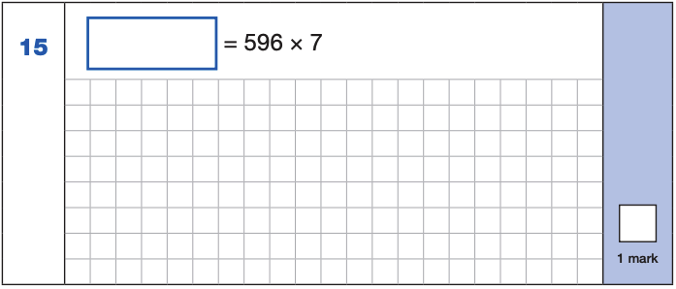
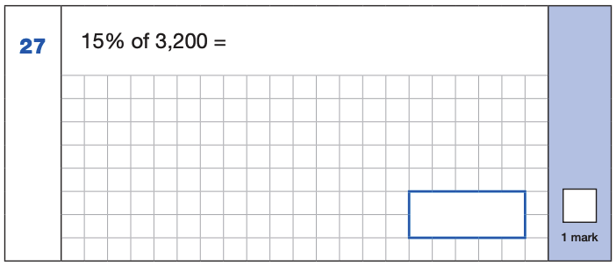
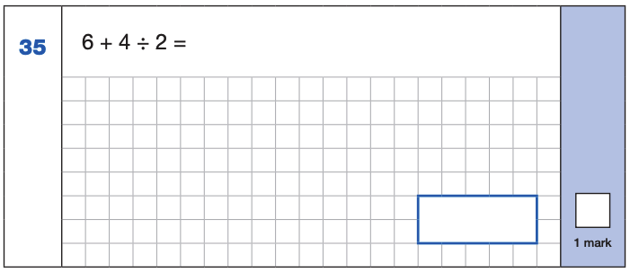
The maths arithmetic paper has a total of 40 marks and lasts for 30 minutes.
The test covers the four operations (addition, subtraction, multiplication, division, including order of operations requiring BIDMAS), percentages of amounts and calculating with decimals and fractions.
ONE MARK
4,172
6.48
+ 8.6 .
15.08
¹
596
x 7
4172
⁶ ⁴
15.08
10% of 3,200 = 320
5% of 3,200 = 160
15% of 3,200 = 480
4 ÷ 2 = 2
6 + 2 = 8
480
8

Slide 16
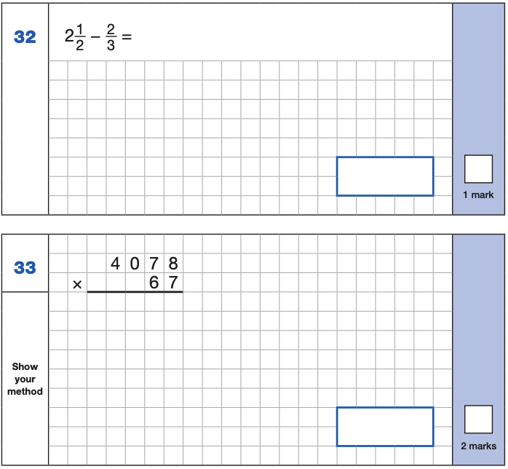
Maths Paper 1 (Arithmetic)
Pg 148 in the planner
Notes:
Identify that there are some questions that have 2 marks and some that have 1.

Slide 17
A sledgehammer to crack a nut
9
9
1
0
97
1
0
1
1
16
1 0 0 0
- 7
9 9 3
x 100
- 9
00
7
000
9700
0 8
9700
7 5 6
5
Notes:
It is also important to know when not to use an algorithm, for example in calculating things like:
1002 – 998
101 + 99
100 × 46 or even 50 × 46
300 ÷ 50
… where more flexible mental methods would be more appropriate than a standard algorithm being used as a ‘sledge hammer to crack a nut’.

Slide 18
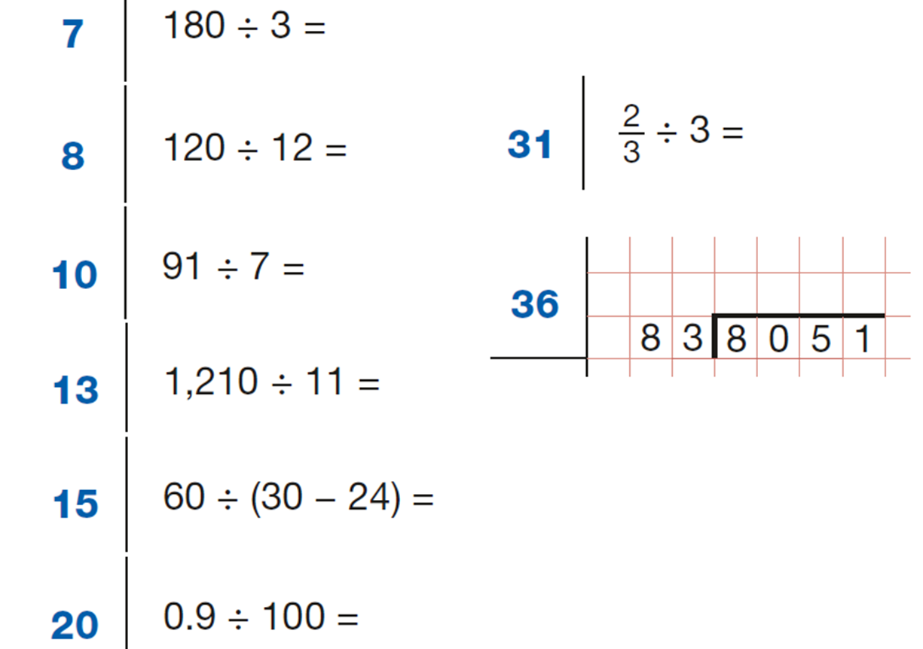
Use of mental strategies

Slide 19
Maths Papers 2 and 3 (Reasoning)
Paper 2 will take place on Wednesday 15th May and paper 3 will take place on Thursday 16th May. These tests have a total of 35 marks each and lasts for 40 minutes each.
These papers require children to demonstrate their mathematical knowledge and skills, as well as their ability to solve problems and their mathematical reasoning. They cover a wide range of mathematical topics from key stage 2 including,
●Number and place value (including Roman numerals);
●The four operations;
●Geometry (properties of shape, position and direction);
●Statistics;
●Measurement (length, perimeter, mass, volume, time, money);
●Algebra;
●Ratio and proportion;
●Fractions, decimals and percentages.

Slide 20
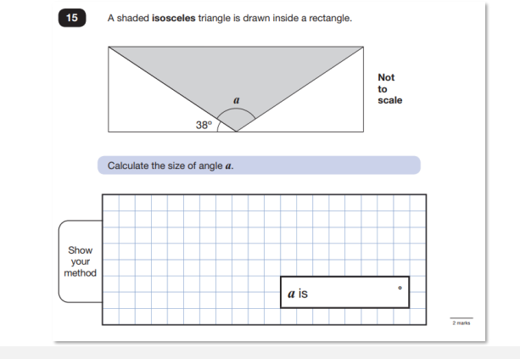
Maths Papers 2 and 3 Reasoning
Questions cover content from Y3- Y6.
40 mins test
Questions range in marks given to each one ( 1- 3)
What do you know?
Need to make notes

Slide 21
MBMS Maths Website
SAT support
Written methods
CGP

